Slide 1
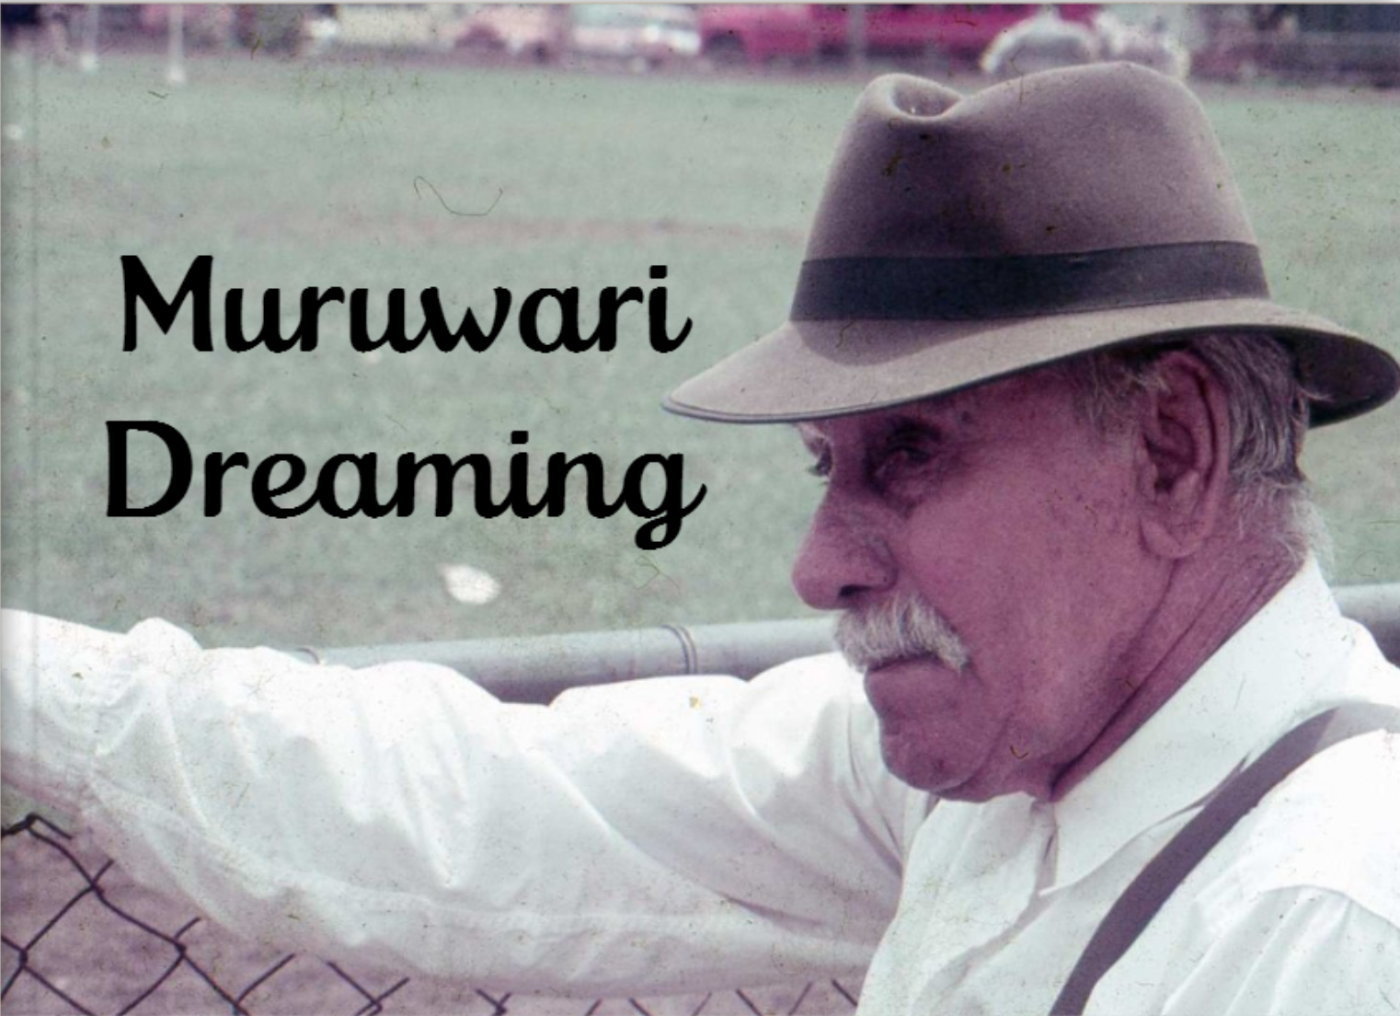
Location suffixes
Verb suffixes
Direction words
George Shearer

Slide 2
Eaglehawk – Muliyan Whistling eagle - Garra

Slide 3
Duck (general word) – Mirringara
Black duck - Gundungal

Slide 4
Domestic dog – Gungarl
Wild dog - Yugi

Slide 5
Emu– Ngurrunj

Slide 6
Kangaroo (general word) – Gula

Slide 7
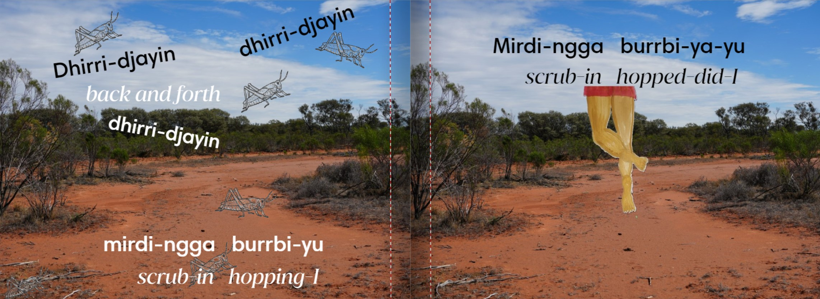
Grasshopper– banda-banda

Slide 8
Sang goanna– Barna

Slide 9
Magpie– Gurlbu

Slide 10
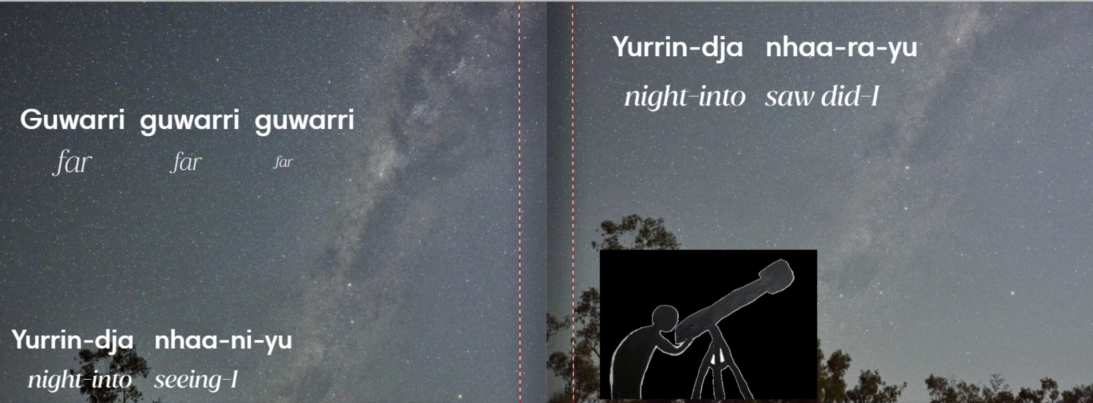
Stars – Mirrinj
The Milky Way (the galaxy) - baruwardu

Slide 12
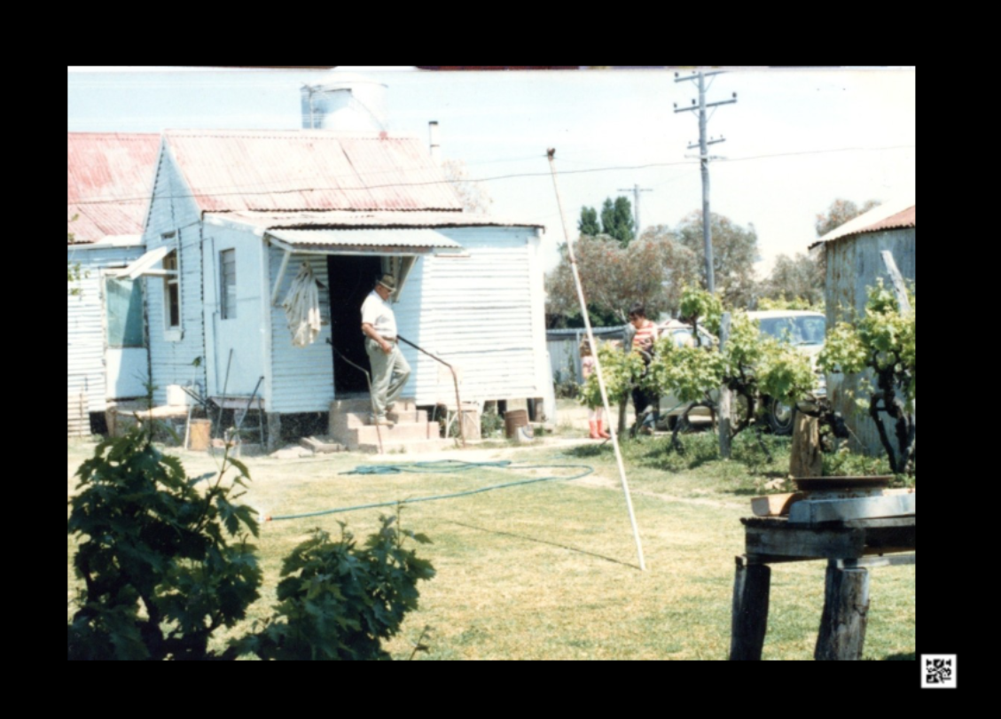
Gami-la-ndu Muruwari-dji yaan-gu-ndu.
When you return home you will be able to talk some Muruwari.

